Slide 1
Continuous Integration Testing for the Einstein Toolkit
Name: Hrishikesh Kalyanaraman
Mentor: Dr Roland Haas

Slide 2
Introduction
Einstein Toolkit is an open-source, community-driven, freely accessible infrastructure for numerical relativity.
Einstein Toolkit contains 300+ regression tests
Tests run when new code is pushed to repo.
Confirms recent additions do not introduce bugs that skew results.

Slide 3
GitHub Actions
GitHub Actions help create workflows
Workflow is a configurable automated process that runs jobs.
Jobs consists of steps that make up workflows.
Workflows can be manually/automatically/periodically triggered.
Einstein Toolkit uses workflows to automatically run regression tests.

Slide 4
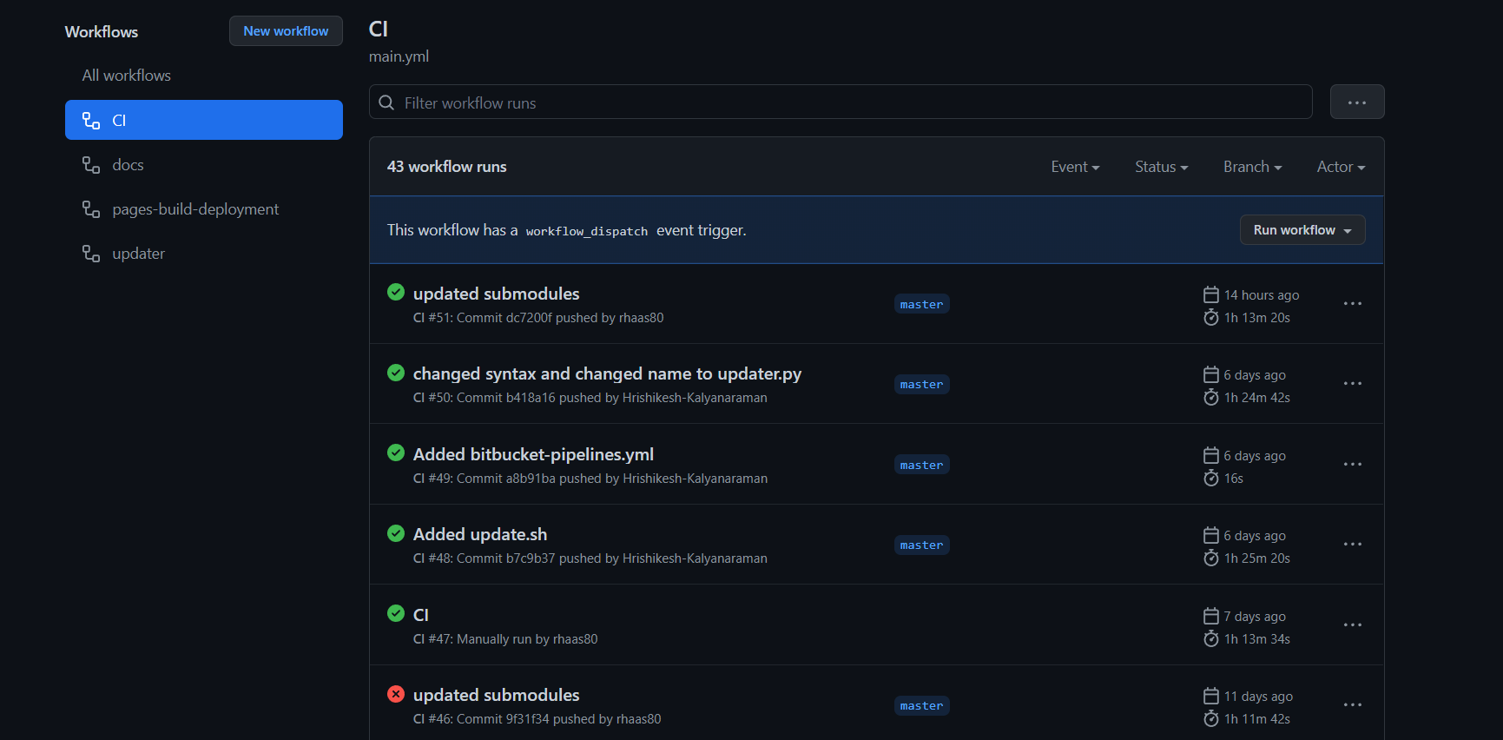

Slide 5
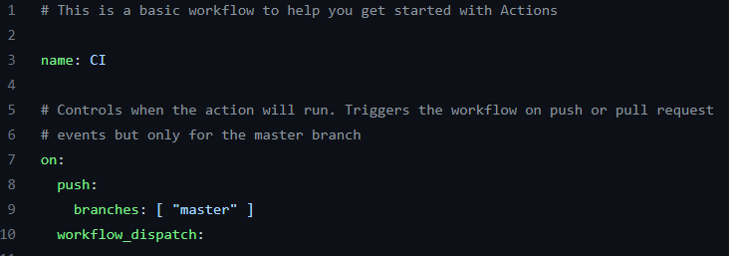
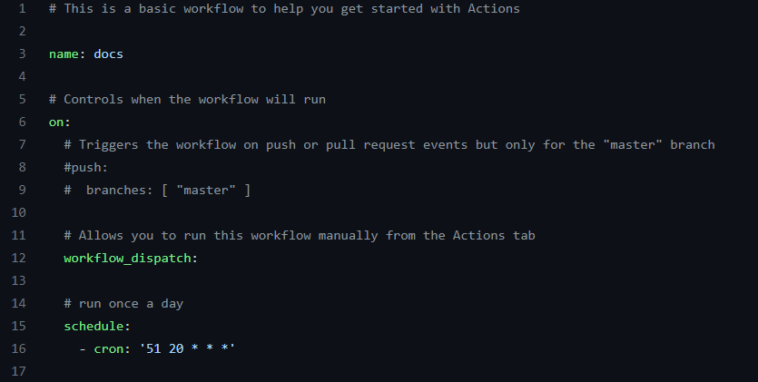

Slide 6
Research Basis
Einstein Toolkit is hosted on GitHub
GitHub workflows automate testing process
Workflow creates HTML Page on build
HTML page summarizes test results

Slide 7
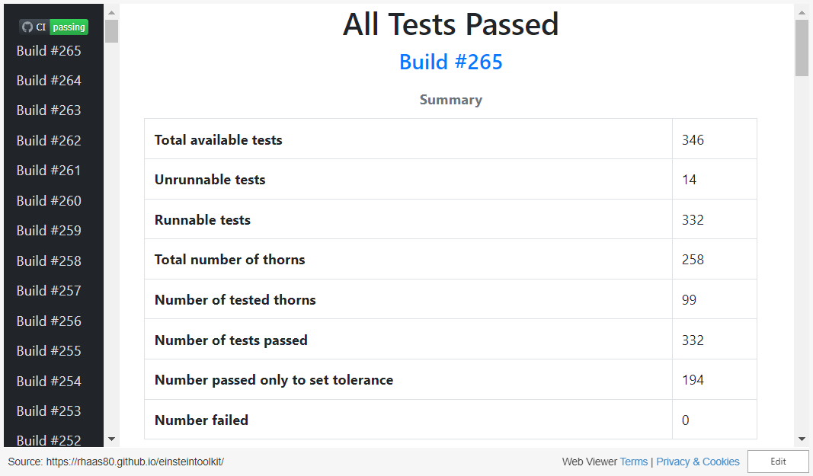

Slide 8
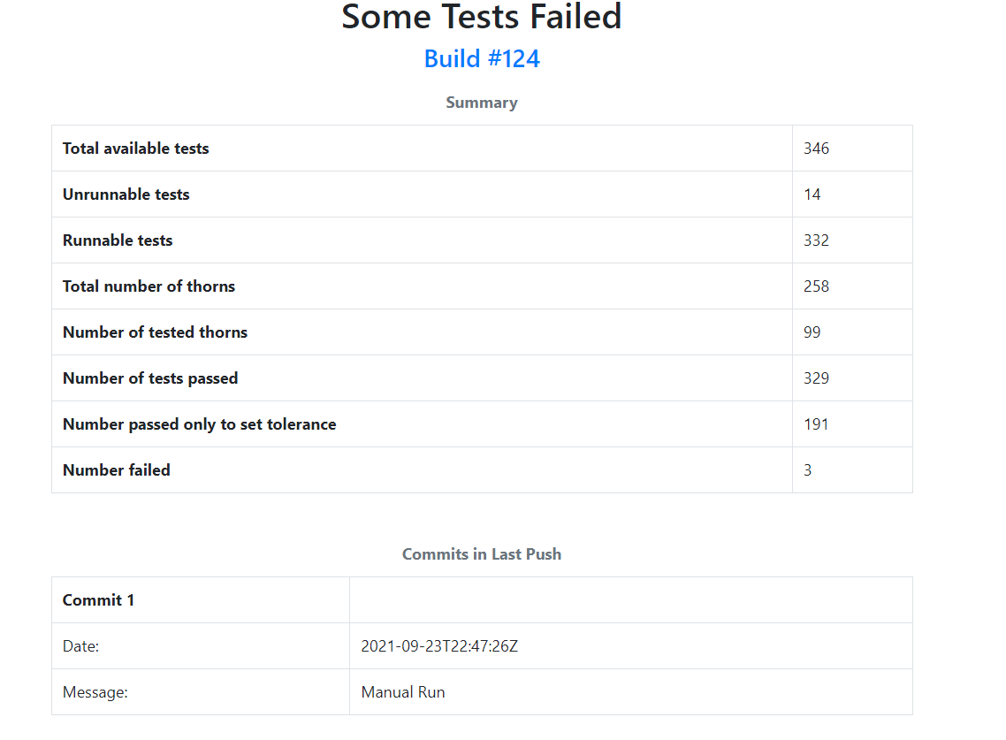

Slide 9
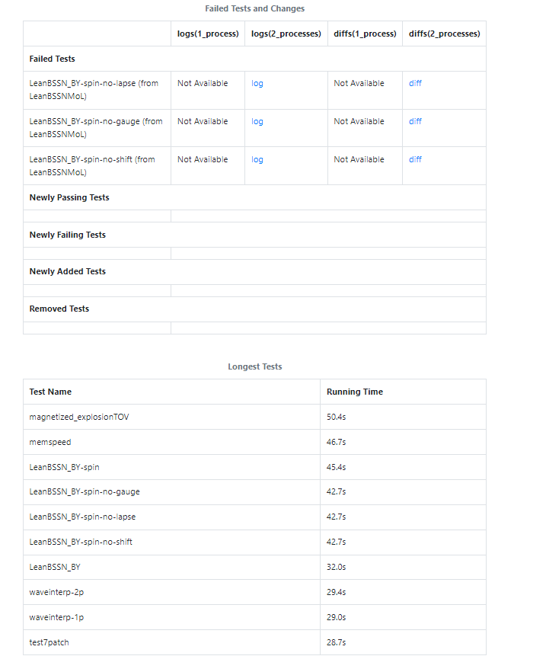

Slide 10
Tasks Achieved
Improve overall HTML Page Design
Partial redesign of plots using bokeh plotting library
Create new python script to automate creation of databases
Resolve pre-existing issues on HTML page
Incorporate new workflow

Slide 11
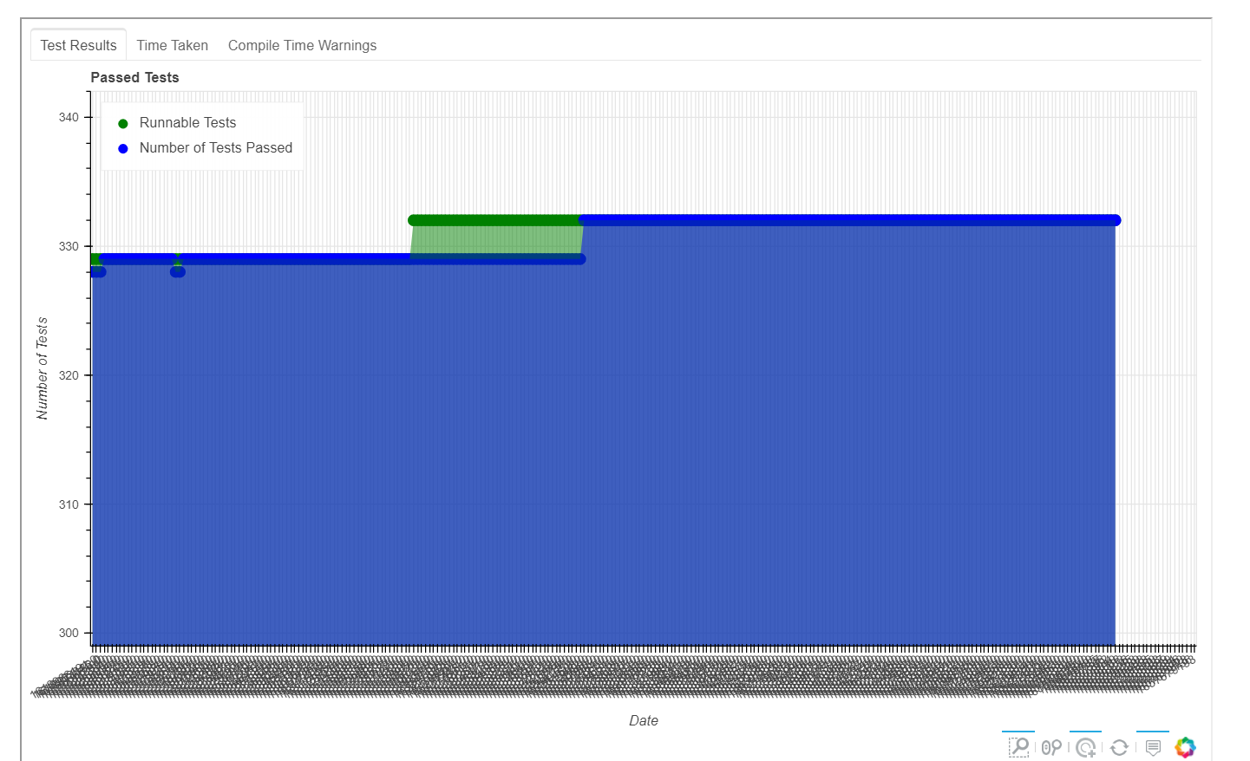

Slide 12
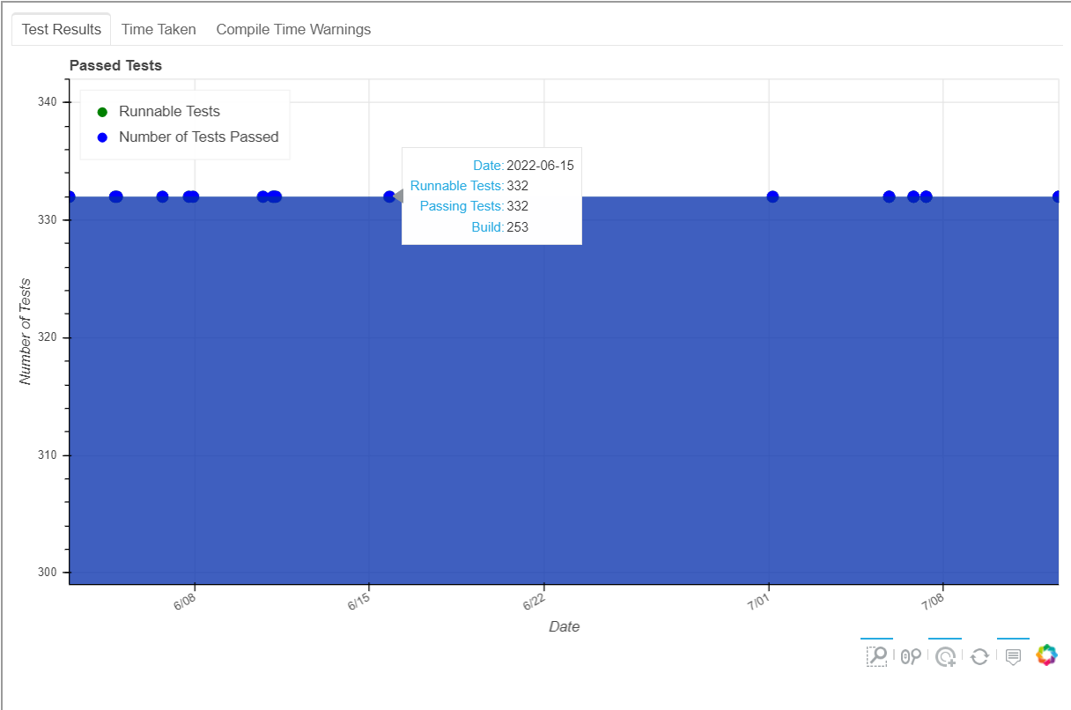

Slide 13
Future
Incorporate new code into existing setup
Adding unit tests to existing Einstein Toolkit code
Check which existing test frameworks can be used for the Einstein Toolkit
Further improve code quality and documentation

